Slide 1

Ecommerce Project
• Goal: Analyse the sales performance of products, categories,
and regions.
• Database Schema Overview: We have 5 tables:
1. Customers
2. Products
3. Orders
4. OrderDetails
5. Regions

Slide 2


1. General Sales Insights
a. What is the total revenue generated over the entire period?
b. Revenue Excluding Returned Orders

Slide 3
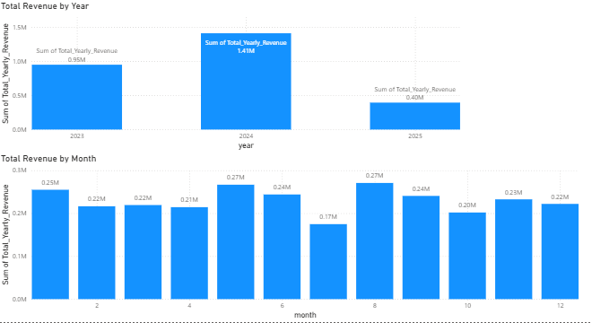
c. Total Revenue per Year / Month

Slide 4
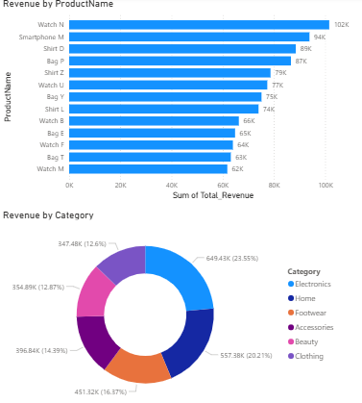
d. Revenue by Product / Category

Slide 5

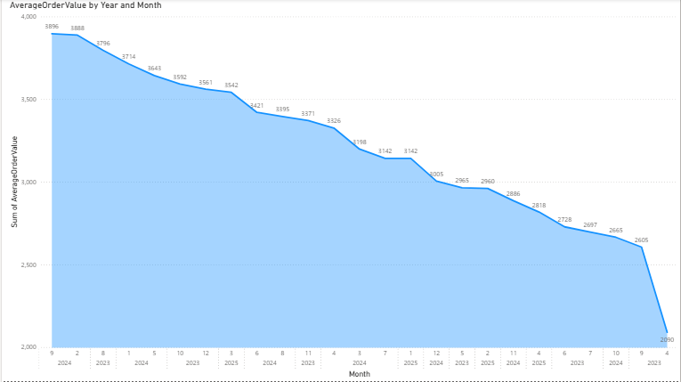
e. What is the average order value (AOV) across all orders?
f. AOV per Year / Month

Slide 6
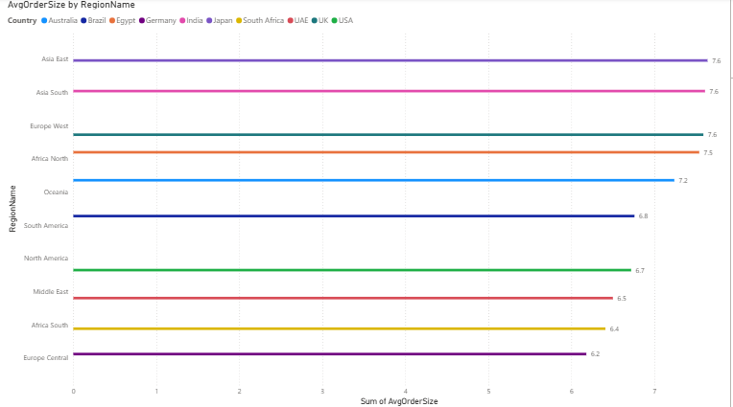
g. What is the average order size by region?

Slide 7
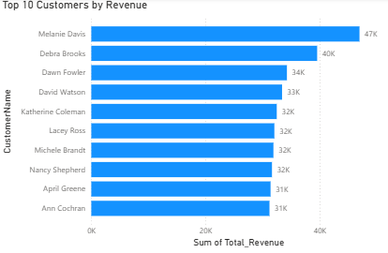
2. Customer insights
a. Who are the top 10 customers by total revenue spent?

Slide 8

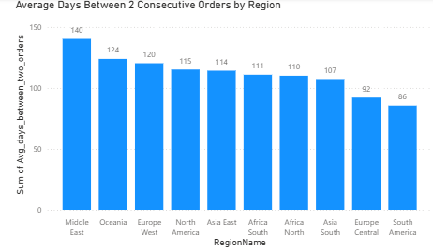
b. What is the repeat customer rate?
c. What is the average time between two consecutive orders for the same customer Region-wise?

Slide 9
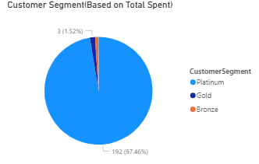
d. Customer Segment (based on total spend)
▪ Platinum: Total Spend > 1500
▪ Gold: 1000–1500
▪ Silver: 500–999
▪ Bronze: < 500

Slide 10
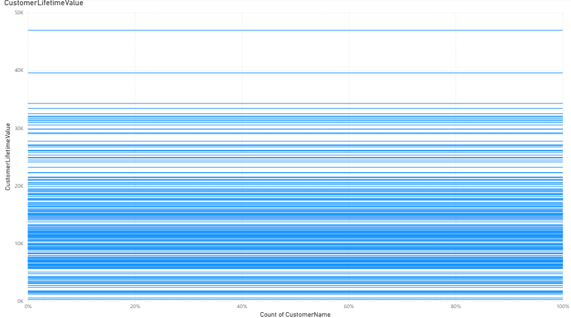
e. What is the customer lifetime value (CLV)?

Slide 11
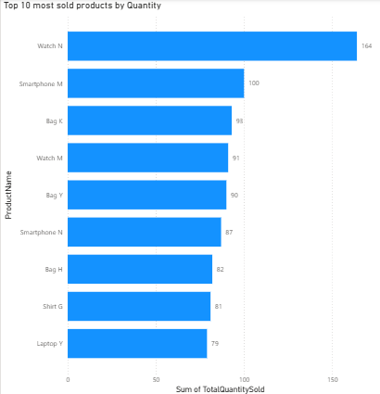
3. Product & Order Insights
a. What are the top 10 most sold products (by quantity)?

Slide 12
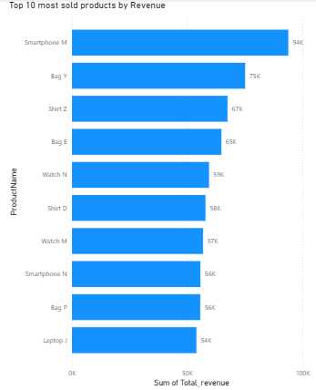
b. Top 10 most sold products (by revenue)?

Slide 13
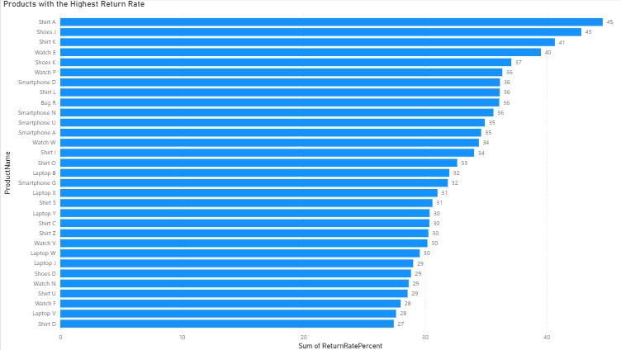
c. Which products have the highest return rate?

Slide 14
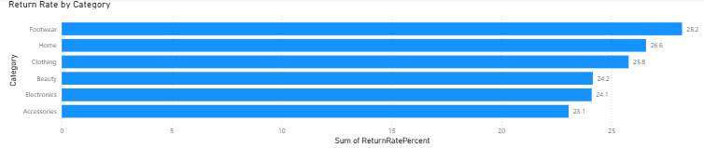
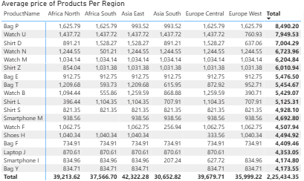
d. Return Rate by Category
e. What is the average price of products per region?

Slide 15
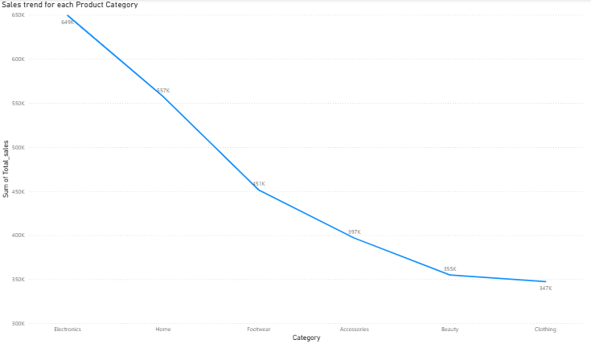
f. What is the sales trend for each product category?

Slide 16
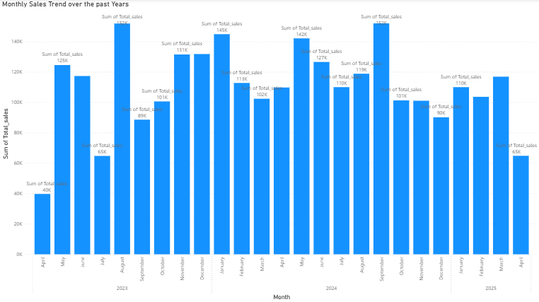
4. Temporal Trends
a. What are the monthly sales trend over the past years?

Slide 17
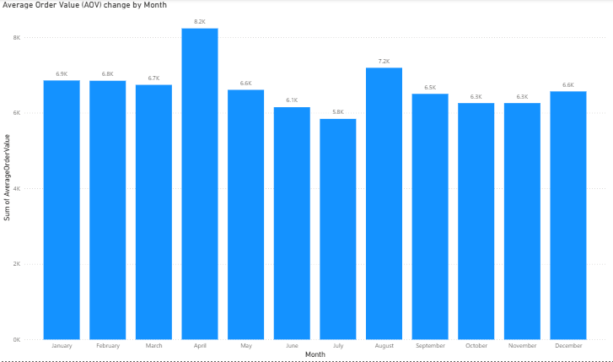
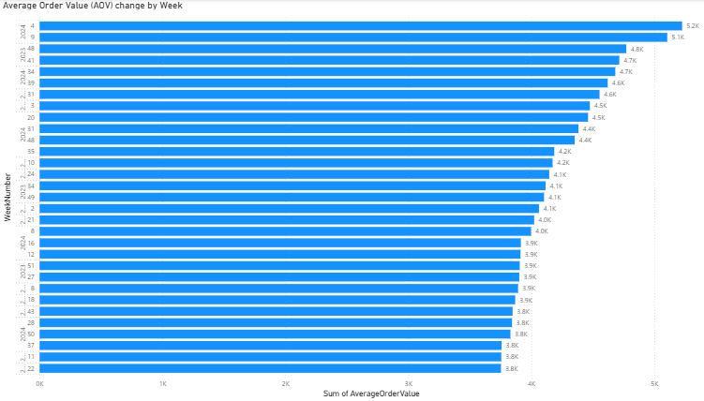
b. How does the average order value (AOV) change by month or week?

Slide 18
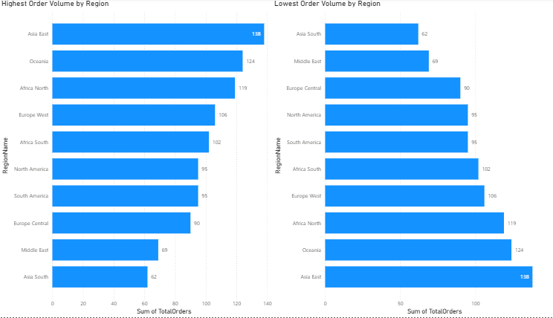
5. Regional Insights
a. Which regions have the highest order volume and which have the lowest?

Slide 19
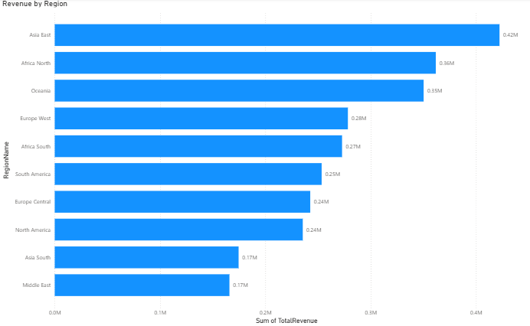
b. What is the revenue per region and how does it compare across different regions?

Slide 20
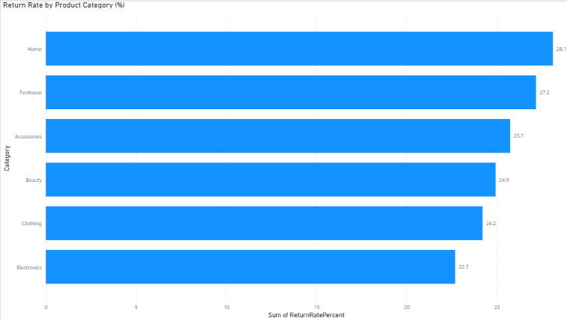
6. Return & Refund Insights
a. What is the overall return rate by product category?

Slide 21
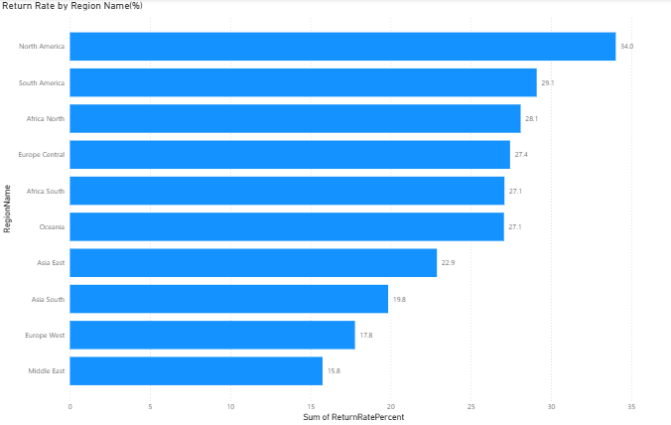
b. What is the overall return rate by region?

Slide 22
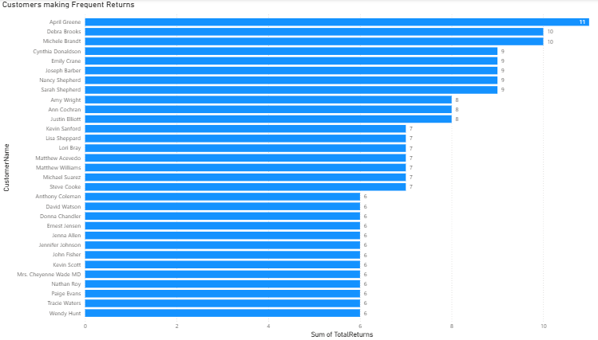
c. Which customers are making frequent returns?

